Slide 1

Selenium Automation Framework: Driving Efficiency with Python & POM
A robust solution for BhojDeals website, ensuring quality and accelerating development cycles.

Slide 2
The Challenge: Manual Testing Bottlenecks
Before automation, the BhojDeals website faced significant testing hurdles:
Slow & Repetitive
Error-Prone Processes
Manual execution of test cases consumed excessive time and resources, hindering release velocity.
Human error in repetitive tasks led to missed defects and inconsistent test coverage.
Missing Key Coverage
UI Volatility
Core workflows like login, search, and checkout lacked comprehensive automation, leaving critical paths vulnerable.
Frequent UI changes made regression testing a constant struggle, often breaking existing test cases.

Slide 3





Strategic Objectives: My Automation Vision
I aimed to build a comprehensive, resilient framework to address these challenges:
Python & Pytest Core
Develop a Selenium automation framework using Python and Pytest for efficient test execution.
Automate Workflows
Ensure end-to-end automation of critical customer journeys across the BhojDeals platform.
Performance & Security
Integrate stress tests for search performance and implement security tests for vulnerabilities like SQL injection.
Modular Design (POM)
Utilize the Page Object Model (POM) for enhanced modularity, maintainability, and code reusability.
Advanced Reporting
Generate detailed HTML reports for quick defect identification and analysis.

Slide 4


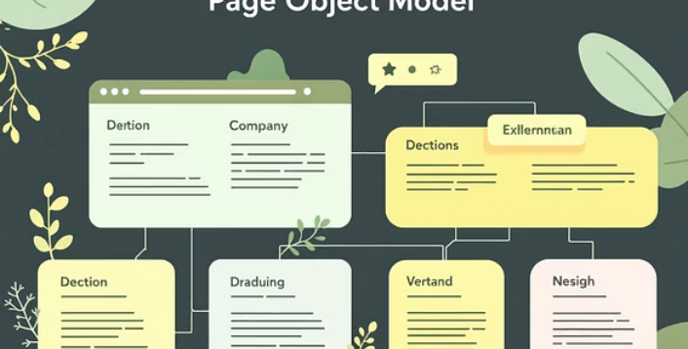


Our Arsenal: Tools and Technologies
Leveraging industry-standard and robust technologies to build a powerful framework:
Python 3.13.9
The primary programming language for its simplicity and extensive libraries.
Selenium WebDriver
For browser automation and interaction with web elements.
Pytest
Our chosen testing framework, providing powerful fixtures and assertion capabilities.
Page Object Model (POM)
Design pattern for creating an object repository for UI elements, improving test maintenance.
ChromeDriver & ChromeOptions
Facilitating browser control and configuration for testing.
pytest-html
For generating comprehensive and visually appealing test reports.
Logging Module
Critical for debugging and tracking test execution flow.
XPath / CSS Selectors
Robust locator strategies for identifying web elements accurately.

Slide 5
Framework Implementation: A Structured Approach
My plan ensured a systematic and efficient development process:
01
02
User Flow Analysis
Scope Definition
Detailed examination of BhojDeals user journeys to identify critical paths for automation.
Clearly outlining which features and functionalities would be covered by the automation.
03
04
Modular Project Structure
POM Development
Designing an intuitive folder structure for test files, page objects, and utility functions.
Creating Page Object classes for each significant web page or component.
05
06
Test Script Development
Stress & Security Integration
Writing concise and readable test scripts that leverage the POM for feature validation.
Embedding performance and security test cases into the overall framework.
07
08
Reporting & Screenshots
Optimization
Configuring automatic report generation and capturing screenshots on test failures.
Refining wait strategies and locator robustness for improved test stability.

Slide 6

Architecture: Design and Development
A clean, modular architecture for maintainability and scalability.
Folder Structure
page_obj/├── add_to_cart/├── checkout/├── filter_pom/├── get_location/├── login/├── login_security/├── search/├── stress_test/└── view_menu/tests/├── test_add_to_cart.py├── test_checkout.py├── test_edit_profile.py├── test_filter.py├── test_getlocation.py├── test_invalid_creden.py├── test_login.py├── test_login_security.py├── test_logout.py├── test_search.py├── test_stress.py└── test_view_menu.pysetup/└── base_test.pyconftest.py
Key Design Principles
Page Object Model (POM): Ensures high modularity by separating UI elements and actions from test scripts.
Feature Isolation: Each module specifically handles one feature, promoting clean separation of concerns.
WebDriver Management: base_test.py centrally manages WebDriver setup and teardown for consistency.
Reporting Integration: conftest.py is used for configuring HTML reports.
Readable Tests: Test scripts remain concise, calling only high-level actions defined in the POM.

Slide 7

Rigor & Assurance: Testing and Validation
A multi-faceted approach to ensure comprehensive quality and security.
Functional Tests
Stress Tests
Covered all major user interactions: Login, Logout, Location selection, Search, Filter, Menu, Cart, Checkout, Profile Editing, and invalid credentials scenarios.
Simulated rapid input of over 70 random words into search, validating system performance under heavy load.
Security Tests
Validation
Implemented measures against common vulnerabilities: SQL injection attempts and brute-force login scenarios.
Utilized explicit assertions and generated timestamped HTML reports for clear evidence.

Slide 8
Overcoming Obstacles: Challenges & Solutions
Navigating technical complexities to build a robust framework:
1
2
Dynamic UI Elements
Unstable Waits
Resolved by developing stronger, more resilient XPath and CSS selectors, moving beyond basic IDs or class names.
Replaced time.sleep() with explicit waits, improving test reliability and execution speed.
3
4
Search Suggestions
Scroll-Heavy Menus
Implemented custom waits and event listeners to handle the asynchronous loading of search suggestions.
Utilized JavaScript Executor for programmatic scrolling, ensuring visibility and interaction with off-screen elements.
5
6
Maintaining Modularity
Code Duplication
Strict adherence to POM principles and clear interface definitions across numerous Page Object modules.
Introduced a base Page class to abstract common WebDriver actions, reducing redundant code and improving maintainability.

Slide 9

Key Takeaways: Learnings & Improvements
Refining our approach for future automation projects:
Locator Strategy
Challenges
Unstable tests and flaky locators
Robust, maintainable selectors
Explicit Waits
Scalable POM
Stabilize timing with wait conditions
Modular page objects for reuse
Mastered Explicit Waits
Robust Locator Strategy
Deepened understanding and application of explicit wait conditions for enhanced test stability.
Developed a hybrid approach using both XPath and CSS selectors for maximum reliability.
Scalable POM Structure
Enhanced Logging & Reporting
Designed a highly modular and scalable Page Object Model that can easily accommodate new features.
Improved debugging capabilities and stakeholder visibility through detailed logs and reports.
Stress & Security Integration
Optimized Performance
Successfully incorporated non-functional testing aspects into the automation framework.
Refined test execution for stability, speed, and overall framework performance.

Slide 10

Conclusion: A Foundation for Future Success
The BhojDeals automation framework is a testament to robust engineering and strategic vision.
Comprehensive Automation
Delivered a complete end-to-end framework covering functional, performance, and security testing.
Significant Efficiency Gains
Drastically reduced manual testing effort, freeing up resources and accelerating release cycles.
Faster, Reliable Releases
Enables rapid deployment of new features with increased confidence in product quality.
Ready for CI/CD & Expansion
Designed for seamless integration into Continuous Integration/Continuous Deployment pipelines and future scalability.
This framework stands as a critical asset, propelling BhojDeals towards continuous innovation and enhanced user experience.

